Slide 1

2024 NEBRASKA VETMOM PROPOSAL

Slide 2






NEBRASKA VETERANS MISSION OF MERCY EVENT
NATIONAL ARMY GUARD TITAN READINESS CENTER
CAMP MEAD YUTAN NEBRASKA
DATES 14-16 NOVEMBER 2024
This Photo by Unknown Author is licensed under CC BY-SA
This Photo by Unknown Author is licensed under CC BY-SA
This Photo by Unknown Author is licensed under CC BY-SA
This Photo by Unknown Author is licensed under CC BY-SA
This Photo by Unknown Author is licensed under CC BY

Slide 3

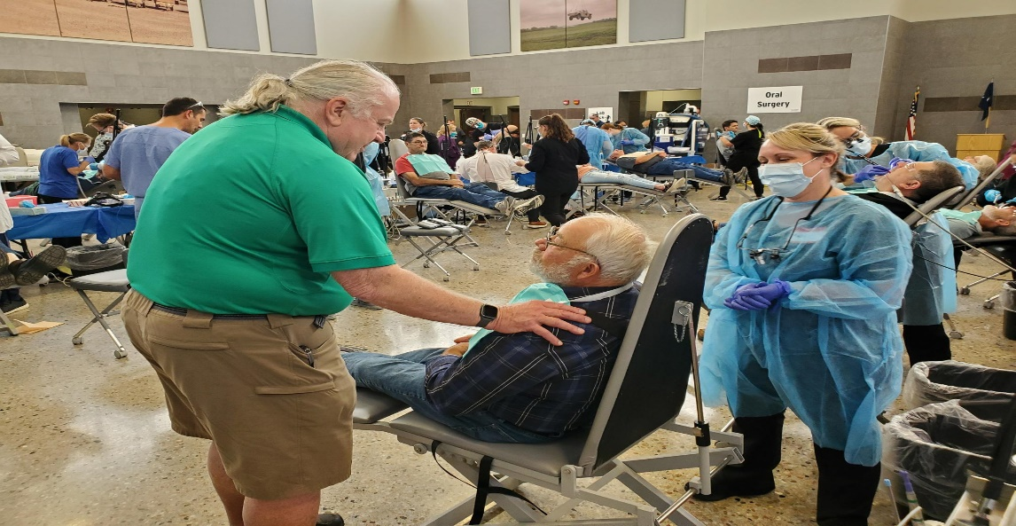
NEBRASKA VETERAN DENTAL CARE NEED
“Approximately 119,645 veterans reside in Nebraska. Around 90% of veterans do not receive dental care through the USDVA. The lack of access to affordable dental care for veterans is the number one requested need of Nebraska Veterans and likely across the United States”
Levi E. Bennett
Deputy Director
Nebraska Department of Veterans’ Affairs
This Photo by Unknown Author is licensed under CC BY-SA
This Photo by Unknown Author is licensed under CC BY-SA
This Photo by Unknown Author is licensed under CC BY-SA
This Photo by Unknown Author is licensed under CC BY-SA
This Photo by Unknown Author is licensed under CC BY

Slide 4


2023 VETMOM ACHIEVEMENTS
250+ DENTAL VOLUNTEERS
200+ NON-DENTAL VOLUNTEERS
353 VETERAN/SPOUSE ENCOUNTERS
2323 DENTAL SERVICES PROVIDED
60 PATIENTS RECEIVED DENTURES
45 PATIENTS REFERRED FOR DENTURES
65 AVERAGE VETERAN AGE
36% RURAL RESIDENTS
92% WOULD ATTEND FUTURE EVENT
TOTAL CARE VALUE: $406,512
This Photo by Unknown Author is licensed under CC BY-SA
This Photo by Unknown Author is licensed under CC BY-SA
This Photo by Unknown Author is licensed under CC BY-SA
This Photo by Unknown Author is licensed under CC BY-SA
This Photo by Unknown Author is licensed under CC BY

Slide 5
2023 VETMOM EXPENSES
ADCF EQUIPMENT 28,000
ADCF DEPOSIT 10,000
DENTAL SUPPLIES 13,500
FOOD AND DRINKS 2100
REGISTRATION SITE 750
STORAGE UNIT 715
VETERAN DISPLAY 500
MISSION SOFTWEAR 500
ELECT/PLUMB DONATION
APPROX TOTAL: $56,000
This Photo by Unknown Author is licensed under CC BY-SA
This Photo by Unknown Author is licensed under CC BY-SA
This Photo by Unknown Author is licensed under CC BY-SA
This Photo by Unknown Author is licensed under CC BY-SA
This Photo by Unknown Author is licensed under CC BY

Slide 6
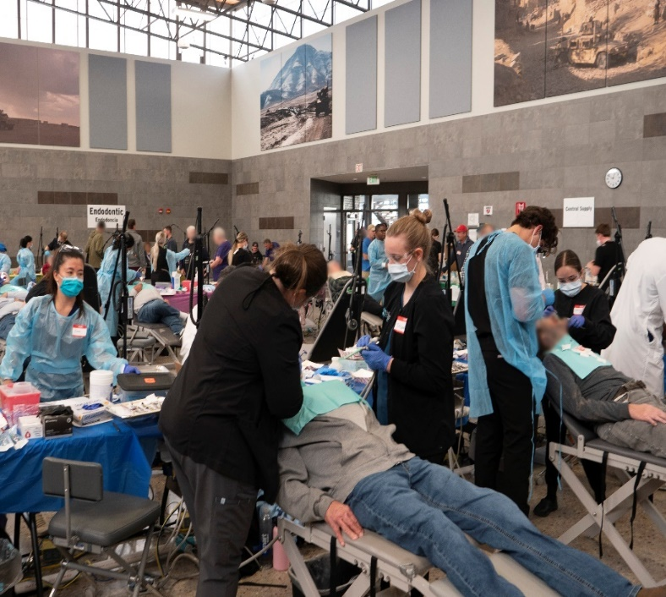
2024 VETMOM PARTNERS:
NEBRASKA DENTAL FOUNDATION
DHHS OFFICE OF ORAL HEALTH
NEBRASKA NATIONAL GUARD
NEBRASKA DEPT OF VETERANS’ AFFAIRS
NEBRASKA DENTAL ASSOCAITION
NEBRASKA DENTAL HYGIENE ASSOCAITION
UNMC COLLEGE OF DENTISTRY
CREIGHTON UNI SCHOOL OF DENTISTRY
AMERICA DENTIST CARE FOUNDATION
DENTAL DESIGNS LABORATORY
DEXIS IMAGING SOLUTIONS
PATTERSON DENTAL SUPPLY
This Photo by Unknown Author is licensed under CC BY-SA
This Photo by Unknown Author is licensed under CC BY-SA
This Photo by Unknown Author is licensed under CC BY-SA
This Photo by Unknown Author is licensed under CC BY-SA
This Photo by Unknown Author is licensed under CC BY

Slide 7
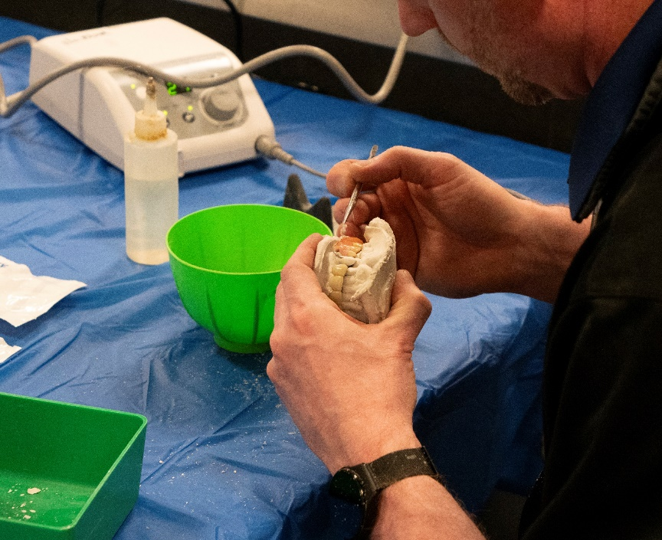
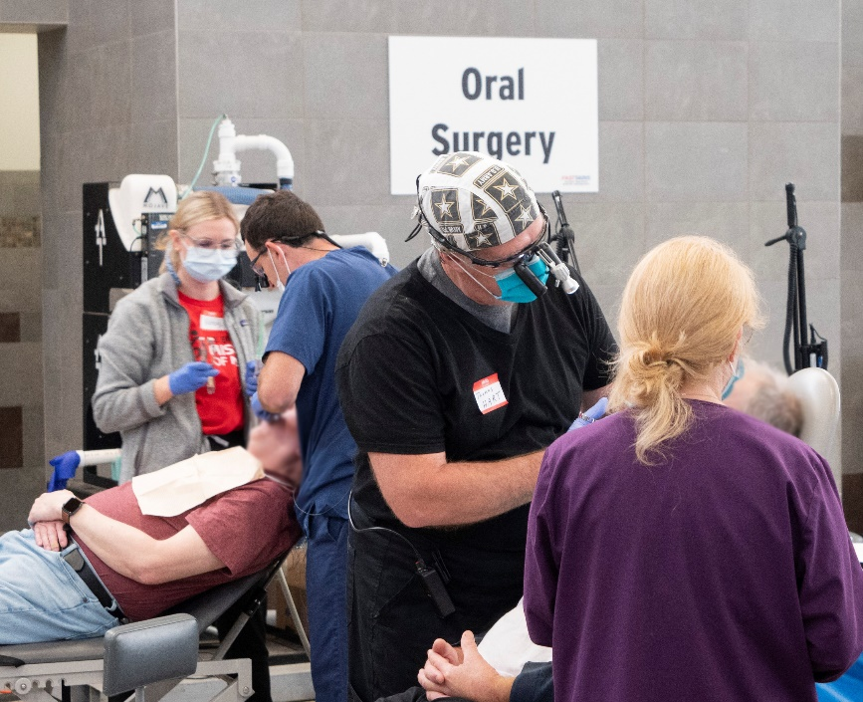
2024 VETMOM GOALS
INCREASE APPOINTMENT SLOTS TO ACCOMMODATE APPROXIMATELY 500 VETERANS AND SPOUSES
RECRUIT APPROXIMATELY 250
DENTAL VOLUNTEER PERSONNEL
PROVIDE 100 PAIRS OF DENTURES
PROVIDE AT LEAST 3,000 DENTAL SERVICES WITH A VALUE OF
APPROXIMATLEY $500,000
This Photo by Unknown Author is licensed under CC BY-SA
This Photo by Unknown Author is licensed under CC BY-SA
This Photo by Unknown Author is licensed under CC BY-SA
This Photo by Unknown Author is licensed under CC BY-SA
This Photo by Unknown Author is licensed under CC BY

Slide 8

2024 VETMOM EXPENSES
Estimated
ADCF EQUIPMENT 40,000
DENTAL SUPPLIES 15,000+
ELECT/PLUMB COSTS 5,000+
FOOD AND DRINKS 3,500
EVENT PROMOTION 2000+
COMPUTER SOFTWEAR 1500
VETERAN DISPLAY 500
APPROX TOTAL: $67,500+
This Photo by Unknown Author is licensed under CC BY-SA
This Photo by Unknown Author is licensed under CC BY-SA
This Photo by Unknown Author is licensed under CC BY-SA
This Photo by Unknown Author is licensed under CC BY-SA
This Photo by Unknown Author is licensed under CC BY

Slide 9
2024 VETMOM POTENTIAL DONORS
H HORNADY MANUFACTURING
GOOGLE NEBRASKA
DHHS PHHS GRANT
AMERITAS
DELTA DENTAL
BLUE CROSS
LNK COMMUNITY FUND
NDA WEBSITE
BENCO DENTAL
CAREQUEST
LDDA GOLF EVENT JUNE
RAW NERVE CONCERT SEPT
This Photo by Unknown Author is licensed under CC BY-SA
This Photo by Unknown Author is licensed under CC BY-SA
This Photo by Unknown Author is licensed under CC BY-SA
This Photo by Unknown Author is licensed under CC BY-SA
This Photo by Unknown Author is licensed under CC BY

Slide 10
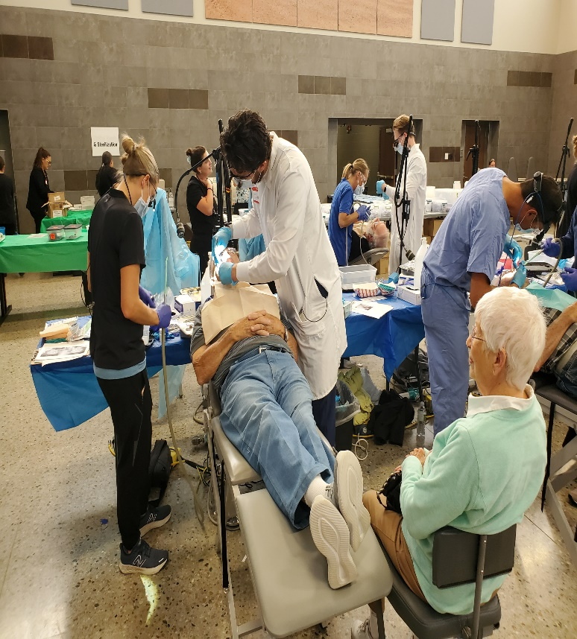
This Photo by Unknown Author is licensed under CC BY-SA
This Photo by Unknown Author is licensed under CC BY-SA
This Photo by Unknown Author is licensed under CC BY-SA
This Photo by Unknown Author is licensed under CC BY-SA
This Photo by Unknown Author is licensed under CC BY

Slide 11
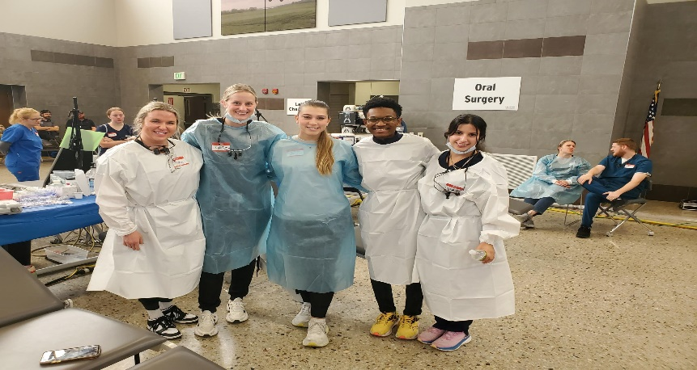
IT IS A PROFESSIONAL HONOR TO SERVE THOSE
WHO HAVE SERVED OUR COUNTRY!!!
This Photo by Unknown Author is licensed under CC BY-SA
This Photo by Unknown Author is licensed under CC BY-SA
This Photo by Unknown Author is licensed under CC BY-SA
This Photo by Unknown Author is licensed under CC BY-SA
This Photo by Unknown Author is licensed under CC BY

Slide 12
NEBRASKA VETMOM 2024 CONTACTS:
-Dr Charles F. Craft charles.craft@nebraska.gov
NE State Dental Health Director #402-432-4482
-David O’Doherty JD david@allophone.com
Director Nebraska Dental Foundation #402-440-7693
-Levi Bennett levi.bennett@nebraska.gov
Deputy Director NDVA #531-739-8032
-Dr. Jim Jenkins jfjenkins@unmc.edu
UNMC College of Dentistry #402-525-5521
-Dr. Steve Anderson stevefa@kdsi.net
Grand Island #308-380-6544
This Photo by Unknown Author is licensed under CC BY-SA
This Photo by Unknown Author is licensed under CC BY-SA
This Photo by Unknown Author is licensed under CC BY-SA
This Photo by Unknown Author is licensed under CC BY-SA
This Photo by Unknown Author is licensed under CC BY

